Slide 1


6
Repeating Instructions
C# Programming: From Problem Analysis to Program Design
4th Edition

Slide 2
Chapter Objectives
Learn why programs use loops
Write counter-, state-, and sentinel-controlled while loops
Examine the conditional expressions that make up a for loop
Be introduced to the foreach looping structure

Slide 3
Chapter Objectives (continued)
Compare the do…while looping structure with the predefined forms of loops
Write loops nested inside other loops
Learn about keywords that can be used for unconditional transfer of control

Slide 4
Chapter Objectives (continued)
Be introduced to recursion and learn how recursive methods work
Pick appropriate loop structures for different applications
Work through a programming example that illustrates the chapter’s concepts

Slide 5
Why Use A Loop?
Repeat instructions with many data sets
Repetition or iteration structures
Rich set of looping structures
while
do…while
for
foreach statements

Slide 6
Using the while Statement
Simplest and most frequently used loop
while (conditional expression)
statement(s);
Expression – sometimes called loop condition
Returns a Boolean result of true or false
No semicolon after the conditional expression
Null body→ empty bodied loop→ infinite loop
Enclose multiple statements for body in { }

Slide 7
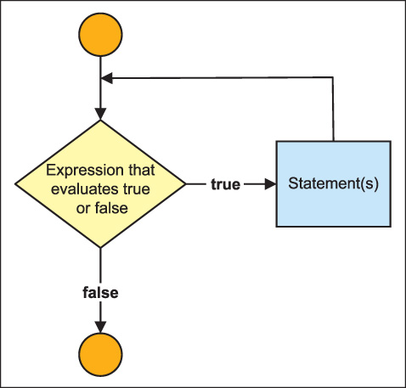
while Statement
Pretest
If the conditional expression evaluates to true, statement(s) performed
If the conditional expression evaluates to false, statement(s) skipped
Figure 6-1 Pretest loop

Slide 8
Counter-Controlled Loop
Loop control variable
Variable simulating a counter
Initialized
Conditional expression designed so that you can exit the loop after a certain number of iterations
Increment counter with each iteration
Otherwise, infinite loop

Slide 9
Counter-Controlled Loop Example
/* SummedValues.cs Author: Doyle */
int sum = 0; //Line 1
int number = 1; //Line 2
while (number < 11) //Line 3
{ //Line 4
sum = sum + number; //Line 5
number++; //Line 6
} //Line 7
Console.WriteLine("Sum of values " //Line 8
+ "1 through 10" //Line 9
+ " is " + sum); //Line 10

Slide 10
Counter-Controlled Loop (continued)
Careful though must focus on how the loop will end with normal termination
Common problem
Off-by-one error
Loop body not executed for the last value OR
Loop body executed one too many times

Slide 11
Counter-Controlled Loop (continued)
Could modify previous example and let user input first and/or last values to be summed
Console.Write("Enter the beginning value: ");
inValue = Console.ReadLine();
if (int.TryParse(inValue, out startValue) == false)
Console.WriteLine("Invalid input - 0 recorded for start value");
Console.Write("Enter the last value: ");
inValue = Console.ReadLine();
if (int.TryParse(inValue, out endValue) == false)
Console.WriteLine("Invalid input - 0 recorded for end value");
while (startValue < endValue + 1)
Last number should be added to the total.

Slide 12
Counter-Controlled Loop (continued)
while (startValue < endValue + 1)
What happens when user enters value for startValue that is larger than endValue?
What happens when user enters value for startValue that is equal to endValue?
What happens when user enters value an alphabetic character for startValue or endValue?

Slide 13
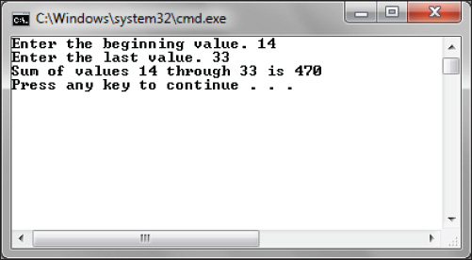
Counter-Controlled Loop (continued)
Figure 6-2 Example of output from user-entered loop boundaries

Slide 14
Sentinel-Controlled Loop
Exact number of times loop body should execute is not known
Often used for inputting data
Prime read on outside of loop
Also referred to as indefinite loops
Select a sentinel value
Extreme value or dummy value
Sentinel value used as operand in conditional expression
Tells user what value to type to end loop

Slide 15
Sentinel-Controlled Loop Example
/* InputValuesLoop.cs Author: Doyle */
static void Main( )
{
string inValue = ""; //Initialized to empty body
Console.Write("This program will let you enter value after value.");
Console.WriteLine("To Stop, enter = -99");
while (inValue!= "-99")
{
Console.WriteLine("Enter value (-99 to exit)");
inValue = Console.ReadLine();
}
Console.ReadKey( ); }

Slide 16
Sentinel-Controlled Loop (continued)
Useful for loops that process data stored in a file
Sentinel is placed as last entry in file
Conditional expression must match selected sentinel value

Slide 17
Sentinel-Controlled Loop (continued)
/* PrimeRead.cs Author: Doyle */
static void Main( )
{
string inValue = ""; //Initialized to null
int sum = 0,
intValue;
Console.Write("This program will let you enter");
Console.Write(" value after value. To Stop, enter");
Console.WriteLine(" -99");
Console.WriteLine("Enter value (-99 to exit)");
inValue = Console.ReadLine(); // Priming read

Slide 18
Sentinel-Controlled Loop (continued)
while (inValue!= "-99")
{
if (int.TryParse(inValue, out intValue) == false)
Console.WriteLine("Invalid input - 0 stored in intValue");
sum += intValue;
Console.WriteLine("Enter value (-99 to exit)");
inValue = Console.ReadLine();
}
Console.WriteLine("Total values entered {0}", sum);
Console.ReadKey( );
}

Slide 19
Windows Applications Using Loops
Event-driven model
Manages the interaction between user and GUI by handling repetition for you
Designed with graphical user interface (GUI)
Predefined class called MessageBox
Used to display information to users through its Show( ) method

Slide 20
Windows Applications Example
/* SquaredValues.cs Author: Doyle */
using System;
using System.Windows.Forms; //Namespace for Windows Form class
namespace SquaredValues
{
class SquaredValues
{
static void Main( )
{
int counter = 0;
string result ="";

Slide 21
Windows Applications Example (continued)
/* SquaredValues.cs - continued */
while (counter < 10)
{
counter++;
result += " \t“+ counter + " \t" // Notice use of += to build
+ Math.Pow(counter, 2) + "\n"; // string for MessageBox
}
MessageBox.Show(result, “1 through 10 and their squares”);
}
}
}

Slide 22
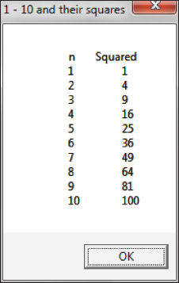
Windows Applications Example (continued)
Figure 6-3 MessageBox dialog output

Slide 23
Windows Applications
To use MessageBox class in console application
Add a reference to System.Windows.Forms.dll
View > Solutions Explorer
Right-click on the Reference folder
Add Reference
Add using directive to System.Windows.Forms namespace in program
using System.Windows.Forms;

Slide 24
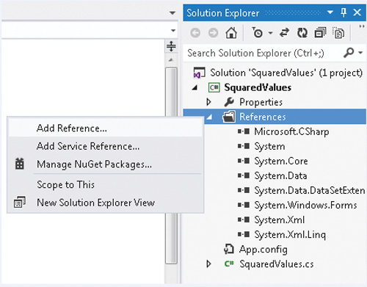
Windows Applications (continued)
Figure 6-4 Add a reference to a project

Slide 25
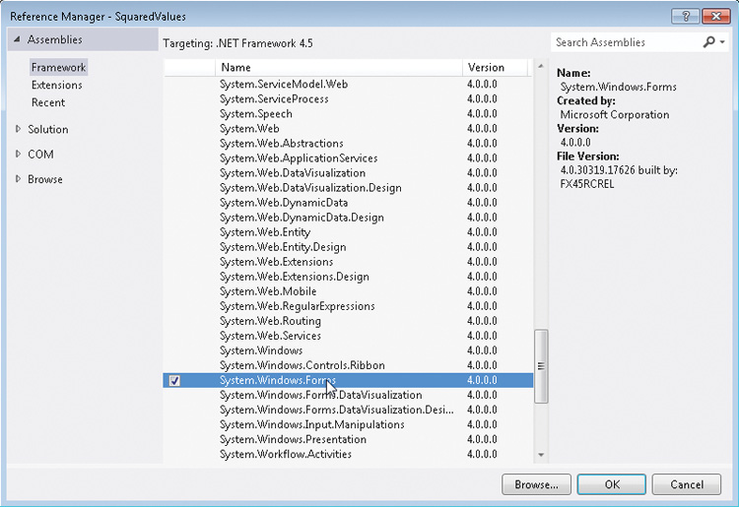
Windows Applications (continued)
Add Reference to System.Windows.Forms
Figure 6-5 Class libraries of .NET

Slide 26
Windows MessageBox Class
MessageBox – dialog box
Invoke MessageBox.Show( ) method
MessageBox.Show( ) method is overloaded
One signature for MessageBox.Show( )
First argument – string displayed in window
Second argument – caption for Window title bar
Third argument – type of dialog button
Fourth argument – button type

Slide 27
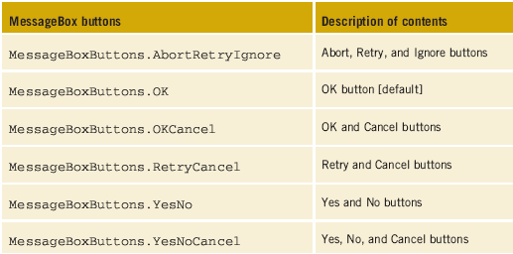
MessageBox class
MessageBox.Show("Do you want another number ?", "State Controlled Loop",
MessageBoxButtons.YesNo, MessageBoxIcon.Question)
Table 6-1 Dialog button arguments

Slide 28
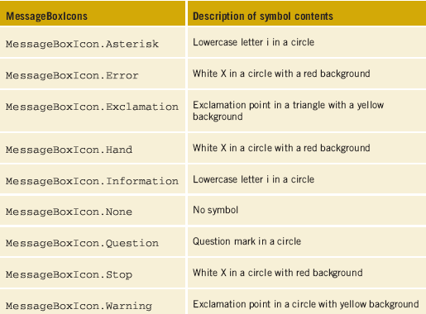
MessageBox class (continued)
MessageBox.Show("Do you want another number ?", "State Controlled Loop",
MessageBoxButtons.YesNo, MessageBoxIcon.Question)
Table 6-1 Dialog
button arguments

Slide 29
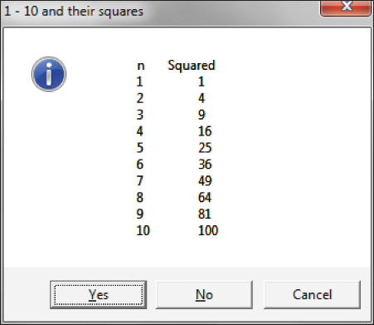
MessageBox class (continued)
Figure 6-6 Button and icon arguments to MessageBox.Show( )

Slide 30
Loop with MessageBox.Show( )
Output displayed after loop is over
while (counter < 10)
{
counter++;
result += " \t " + counter + " \t"
+ Math.Pow(counter, 2) + "\n";
}
MessageBox.Show(result, "1 - 10 and their squares",
MessageBoxButtons.YesNoCancel, MessageBoxIcon.Information);
Grow the string inside the loop… display result after loop is finished

Slide 31
State-Controlled Loops
Similar to sentinel-controlled loop
Referred to as flag-controlled loops
Instead of requiring a dummy or extreme value, use flag variable
Can be Boolean variable (not a requirement)
Variable must be initialized
For each new iteration, evaluate to see when it changes state
Change its value inside the loop – to stop the loop

Slide 32
State-Controlled Loops Example
bool moreData = true;
while (moreData)
{ // moreData is updated inside the loop condition changes
if (MessageBox.Show("Do you want another number ?",
"State Controlled Loop", MessageBoxButtons.YesNo,
MessageBoxIcon.Question) == DialogResult.No)
// Test to see if No clicked
{
moreData = false;
} // End of if statement
// More loop body statements
} // End of while loop

Slide 33
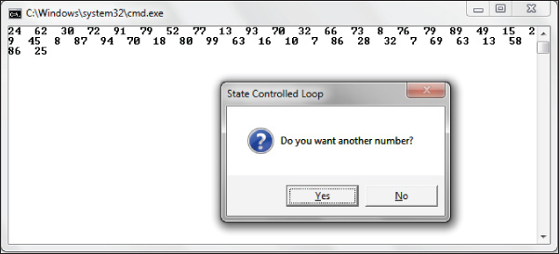
MessageBox.Show( ) Method
MessageBox.Show("Do you want another number ?", "State Controlled Loop",
MessageBoxButtons.YesNo, MessageBoxIcon.Question)
1st argument
2nd argument
4th argument
3rd argument
3rd argument
Figure 6-7 State-controlled loop of random numbers

Slide 34
For Loop
Pretest form of loop (like the while)
Considered specialized form of while statement
Usually associated with counter-controlled types
Packages initialization, test, and update all on one line
General form is:
for (statement; conditional expression; statement)
statement;
Interpreted as:
for (initialize; test; update)
statement;

Slide 35
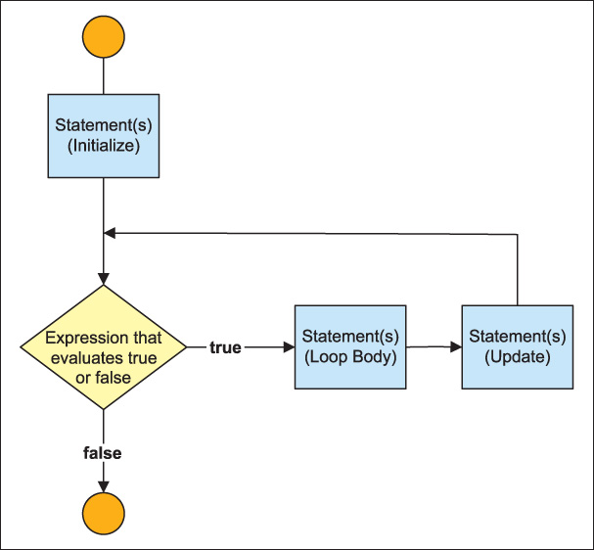
For Loop (continued)
Figure 6-8 Flow of control with a for statement

Slide 36
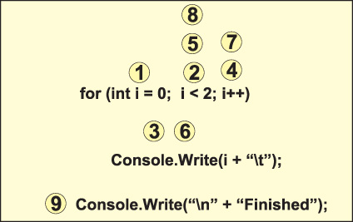
For Loop (continued)
For loop statements are executed in the order shown by the numbered steps
Figure 6-9 Steps of the for statement

Slide 37
Comparison of While and For Statement
int counter = 0;
while (counter < 11)
{
Console.WriteLine("{0}\t{1}\t{2}", counter,
Math.Pow(counter,2), Math.Pow(counter,3));
counter++;
}
for (int counter = 0; counter < 11; counter++)
{
Console.WriteLine("{0}\t{1}\t{2}", counter,
Math.Pow(counter,2), Math.Pow(counter,3));
}
Replace above while loop with for loop below –does same

Slide 38
Output from Examples 6.11 & 6.12
0 0 0
1 1 1
2 4 8
3 9 27
4 16 64
5 25 125
6 36 216
7 49 343
8 64 512
9 81 729
10 100 1000
Output from both the while and for loop examples compared on the previous slide

Slide 39
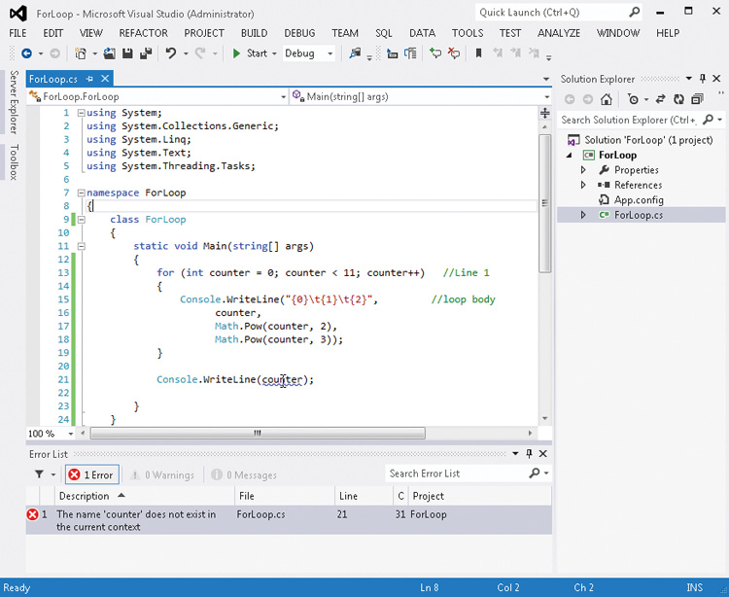
For Loop (continued)
counter is out of SCOPE
Figure 6-10 Syntax error

Slide 40

For Loop (continued)
Avoid declaring variables inside body of loop (inside the curly braces)
With every iteration, a new memory location set aside
Variable looses visibility outside the loop
Use a different identifier than what has already been defined.
Figure 6-11 Redeclaration error message

Slide 41
Ways to Initialize, Test, and Update For Statements
for (int counter = 0, val1 = 10; counter < val1; counter++)
// Compound initialization
for ( ; counter < 100; counter+=10) // No initialization
for (int j = 0; ; j++) // No conditional expression
for ( ; j < 10; counter++, j += 3) // Compound update
for (int aNum = 0; aNum < 101; sum += aNum, aNum++)
; // Null loop body
for (int j = 0,k = 10; j < 10 && k > 0; counter++, j += 3)
// Compound test (conditional expression)

Slide 42
Ways to Initialize, Test, and Update For Statements (continued)
Floating-point variables can be used
for initialization, expressions, and update
for (double d = 15.0; d < 20.0; d += 0.5)
{
Console.Write(d + "\t");
}
The output produced
15 15.5 16 16.5 17 17.5 18 18.5 19 19.5

Slide 43
Ways to Initialize, Test, and Update For Statements (continued)
Can change the loop control variable inside the loop
for (double d = 15.0; d < 20.0; d += 0.5)
{
Console.Write(d + "\t");
d += 2.0
}
The output produced
15 17.5
C# lets you change the conditional expression endValue inside the loop body – BUT, be careful here

Slide 44

Foreach Statement
Used to iterate or move through a collection
Array (Chapter 7)
General form
foreach (type identifier in expression)
statement;
Expression is the collection (array)
Type is the kind of values found in the array
Restriction on foreach—cannot change values
Access to the elements is read-only

Slide 45
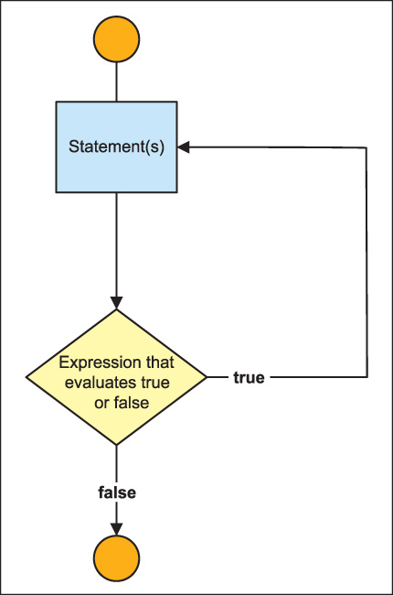
Do…While Statements
Posttest
General form
do
{
statement;
}
while ( conditional expression);
Figure 6-12
Do…while loop

Slide 46
Do…While Example
int counter = 10;
do // No semicolon on this line
{
Console.WriteLine(counter + "\t" + Math.Pow(counter, 2));
counter--;
}
while (counter > 6);
The output of this code is:
10 100
9 81
8 64
7 49

Slide 47
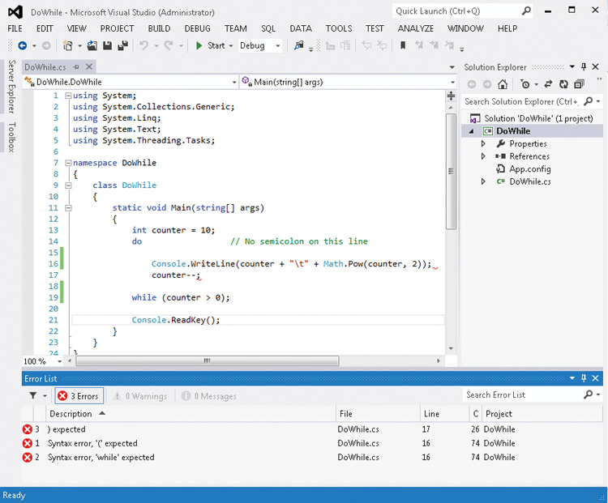
Do…While Example (continued)
No semicolon after do, but curly braces are required…when you have more than one statement between do and while
Figure 6-13 Curly brace required

Slide 48
Nested Loops
Loop can be nested inside an outer loop
Inner nested loop is totally completed before the outside loop is tested a second time
int inner;
for (int outer = 0; outer < 3; outer++)
{
for(inner = 10; inner > 5; inner --)
{
Console.WriteLine("Outer: {0}\tInner: {1}", outer, inner);
}
}
15 lines printed

Slide 49
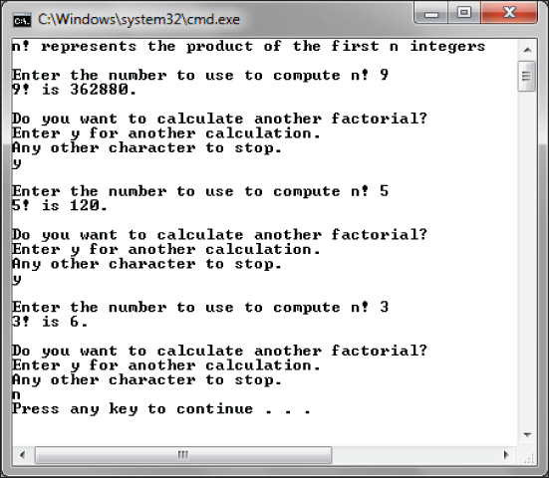
Nested Loops
Review NFactorial Example
Figure 6-14 Nested loop output

Slide 50
NFactorial Example
do //Line 5
{ //Line 6
n = InputN( ); //Line 7
CalculateNFactorialIteratively(n, out result); //Line 8
DisplayNFactorial(n, result); //Line 9
moreData = PromptForMoreCalculations( ); //Line 10
} //Line 11
while (moreData = = "y" || moreData = = "Y"); //Line 12

Slide 51
Nfactorial Example (continued)
public static void //Line 19
CalculateNFactorialIteratively(int n, out int result)
{ //Line 20
result = 1; //Line 21
for (int i = n; i > 0; i--) //Line 22
{ //Line 23
result *= i; //Line 24
} //Line 25
} //Line 26

Slide 52
Recursion
Technique where a method calls itself repeatedly until it arrives at the solution
Algorithm has to be developed so as to avoid an infinite loop
To write a recursive solution, an algorithm has to be developed so as to avoid an infinite loop
Have to identify a base case
Base case is the simplest form of the solution
Other cases are all solved by reducing value and calling the method again

Slide 53
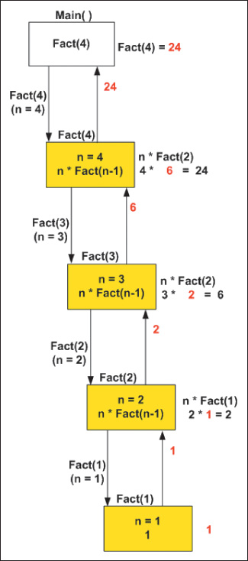
Recursive Call
public static int Fact(int n)
{
if (n == 1 || n == 0)
return 1;
else
return (n * Fact(n-1));
}
Figure 6-15 Recursive evaluation of n!

Slide 54
Unconditional Transfer of Control
break
Used with switch statement
Place in the body of a loop to provide immediate exit
Be careful (Single Entry/Single Exit)
continue
When reached, a new iteration of the nearest enclosing while, do…while, for, or foreach statement is started
Other jump statements
goto, throw, and return
Use sparingly

Slide 55
Break Statement
int total = 0;
for (int nValue = 0; nValue < 10; nValue++)
{
if (nValue == 5)
{
break;
}
total += nValue;
Console.Write(nValue + "\t");
}
Console.WriteLine("\nTotal is equal to {0}.", total);
break and continue both violate the “single entry”, “single exit” guideline for developing a loop
The output is:
0 1 2 3 4
Total is equal to 10.

Slide 56
Continue Statement
int total = 0;
for (int nValue = 0; nValue < 10; nValue++)
{
if (nValue % 2 == 0)
{
continue;
}
total += nValue;
Console.Write(nValue + "\t");
}
Console.WriteLine("\nTotal is equal to {0}.", total);
continue does not stop the loop body; It halts that iteration and transfers control to the next iteration of the loop
The output is:
0 3 5 7 9
Total is equal to 25.

Slide 57
Deciding Which Loop to Use
Sometimes a personal choice
Body of the do…while always executed at least once
Posttest type
Numeric variable being changed by a consistent amount – for statement
While statement can be used to write any type of loop
Pretest type

Slide 58
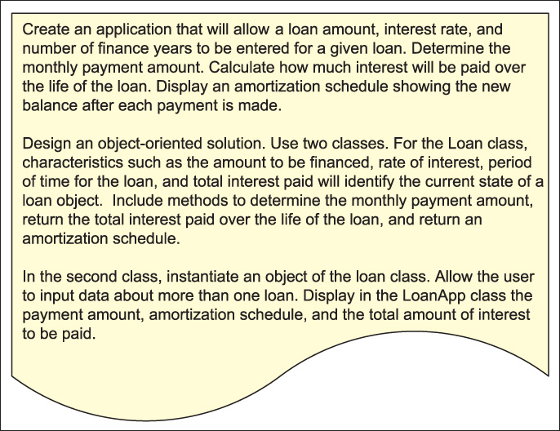
LoanApplication Example
Figure 6-16 Problem specification for LoanApplication example

Slide 59
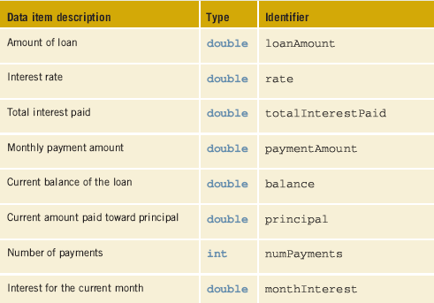
LoanApplication Example (continued)
Table 6-3 Instance field members for the Loan class

Slide 60
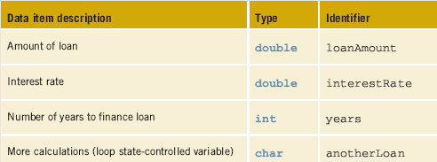
LoanApplication Example (continued)
Table 6-4 Local variables for the LoanApp class

Slide 61
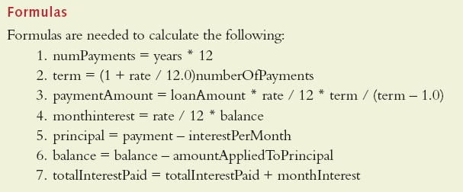
Formulas Used for LoanApplication Example

Slide 62
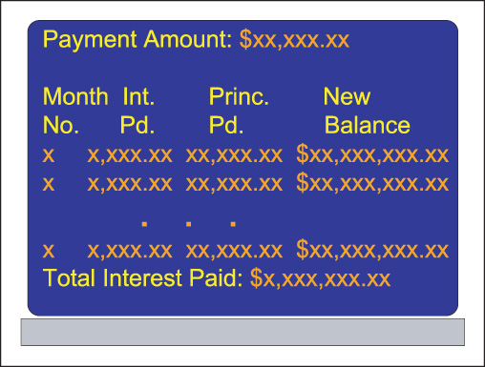
LoanApplication Example (continued)
Figure 6-17 Prototype for the LoanApplication example

Slide 63
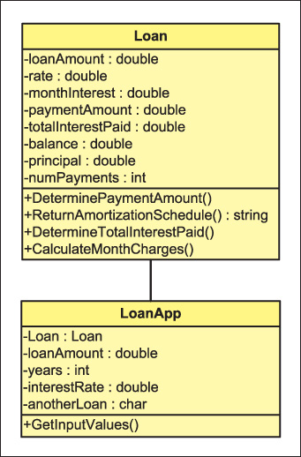
LoanApplication Example (continued)
Figure 6-18 Class diagrams

Slide 64
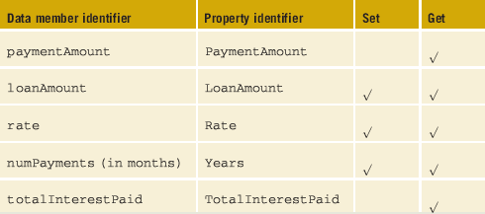
Properties for LoanApplication Example
Table 6-5 Properties for the Loan class

Slide 65
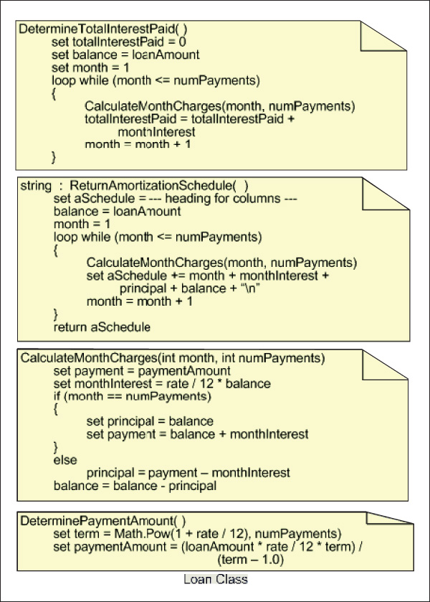
Pseudocode – Loan Class
Figure 6-19 Behavior of
Loan class methods

Slide 66
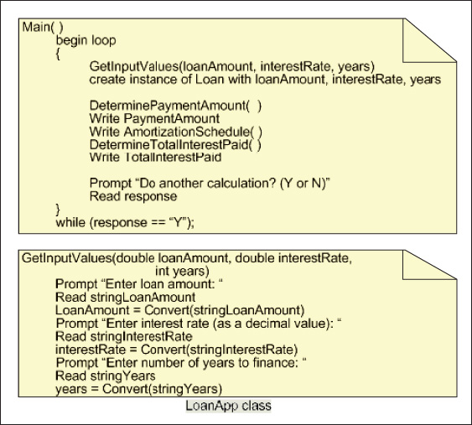
Pseudocode –LoanApp Class
Figure 6-20 Behavior of LoanApp class methods

Slide 67
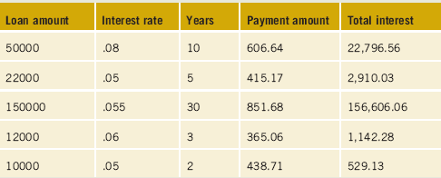
Desk Check of LoanApplication Example
Figure 6-6 LoanApp test values

Slide 68
/* Loan.cs
* Creates fields for the amount of loan, interest rate, and number of years.
* Calculates amount of payment and produces an amortization schedule.
*/
using System;
using System.Windows.Forms;
namespace Loan
{
public class Loan
{
private double loanAmount;
private double rate;
private int numPayments;
private double balance;
private double totalInterestPaid;
private double paymentAmount;
private double principal;
private double monthInterest;
Loan class

Slide 69
// Constructors
public Loan( ) { }
public Loan(double loan, double interestRate, int years)
{
loanAmount = loan;
if (interestRate < 1)
rate = interestRate;
else // In case directions aren't followed
rate = interestRate / 100; // convert to decimal
numPayments = 12 * years;
totalInterestPaid = 0;
}
// Property accessing payment amount
public double PaymentAmount {
get
{
return paymentAmount;
}
}

Slide 70
// Remaining properties defined for each field
// Determine payment amount based on number of years,
// loan amount, and rate
public void DeterminePaymentAmount( )
{
double term;
term = Math.Pow((1 + rate / 12.0), numPayments);
paymentAmount = ( loanAmount * rate / 12.0 * term)
/ (term - 1.0);
}
// Returns a string containing an amortization table
public string ReturnAmortizationSchedule()
{
string aSchedule = "Month\tInt.\tPrin.\tNew";
aSchedule += "\nNo.\tPd.\tPd.\tBalance\n";
balance = loanAmount;

Slide 71
for (int month = 1; month <= numPayments; month++)
{
CalculateMonthCharges(month, numPayments);
aSchedule += month + "\t" + monthInterest.ToString("N2")
+ "\t“ + principal.ToString("N2") + "\t"
+ balance.ToString("C") + "\n";
}
return aSchedule;
}
// Calculates monthly interest and new balance
public void CalculateMonthCharges(int month, int numPayments)
{
double payment = paymentAmount;
monthInterest = rate / 12 * balance;

Slide 72
if (month == numPayments)
{
principal = balance;
payment = balance + monthInterest;
}
else
{
principal = payment - monthInterest;
}
balance -= principal;
}
// Calculates interest paid over the life of the loan
public void DetermineTotalInterestPaid( )
{
totalInterestPaid = 0;
balance = loanAmount;

Slide 73
for (int month = 1; month <= numPayments; month++)
{
CalculateMonthCharges(month, numPayments);
totalInterestPaid += monthInterest;
}
}
}
}
Review LoanApplication Example

Slide 74
/* LoanApp.cs
* Used for testing Loan class. Prompts user for input values.
* Calls method to display payment amount and amortization
* schedule. Allows more than one loan calculation. */
using System;
using System.Windows.Forms;
namespace Loan
{
class LoanApp
{
static void Main( )
{
int years;
double loanAmount;
double interestRate;
string inValue;
char anotherLoan = 'N';
LoanApp class

Slide 75
do
{
GetInputValues(out loanAmount, out interestRate, out years);
Loan ln = new Loan(loanAmount, interestRate, years);
Console.WriteLine( );
Console.Clear( );
Console.WriteLine(ln);
Console.WriteLine( );
Console.WriteLine(ln.ReturnAmortizationSchedule( ));
Console.WriteLine("Payment Amount: {0:C}", ln.PaymentAmount);
Console.WriteLine("Interest Paid over Life of Loan: {0:C} “,
ln.TotalInterestPaid);
Console.Write("Do another Calculation? (Y or N)");
inValue = Console.ReadLine( );
anotherLoan = Convert.ToChar(inValue);
}
while ((anotherLoan == 'Y')|| (anotherLoan == 'y'));
}

Slide 76
// Prompts user for loan data
static void GetInputValues(out double loanAmount,
out double interestRate, out int years)
{
Console.Clear( );
loanAmount = GetLoanAmount( );
interestRate = GetInterestRate( );
years = GetYears( );
}

Slide 77
// Prompts user for loan amount data
public static double GetLoanAmount( )
{
string sValue;
double loanAmount;
Console.Write("Please enter the loan amount: ");
sValue = Console.ReadLine();
while (double.TryParse(sValue, out loanAmount) == false)
{
Console.WriteLine("Invalid data entered for loan amount");
Console.Write("\nPlease re-enter the loan amount: ");
sValue = Console.ReadLine();
}
return loanAmount;
}
}
Review LoanApplication Example

Slide 78
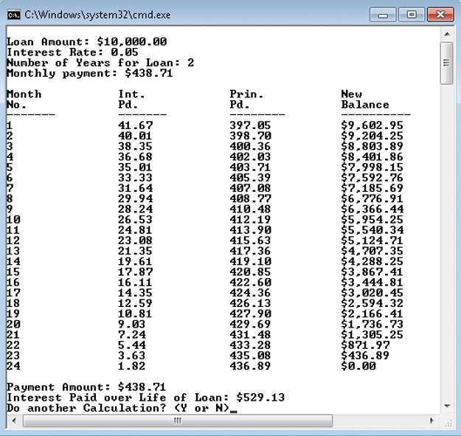
LoanApplication Example
Figure 6-21
LoanApplication
output

Slide 79
Coding Standards
Guidelines for Placement of Curly Braces
Spacing Conventions
Advanced Loop Statement Suggestions

Slide 80
Resources
Loops - C# Tutorial –
http://csharp.net-tutorials.com/basics/loops/
C# Station Tutorial - Control Statements - Loops –
http://www.csharp-station.com/Tutorials/Lesson04.aspx
C# and Loops –
http://www.homeandlearn.co.uk/csharp/csharp_s3p5.html
Dot Net Pearls - C# and Loops –
http://www.dotnetperls.com/loop

Slide 81
Chapter Summary
Major strengths of programming languages attributed to loops
Types of loops
while
Counter-controlled
State-controlled
Sentinel-controlled
for
foreach
do…while

Slide 82
Chapter Summary (continued)
Conditional expressions used with loops
Nested loops
Unconditional transfer of control
Which loop structure should you use?
Loop structures for different types of applications

